Slide 1

Glucose fluid stopper by non-return valve

Slide 2

Introduction
When air enters a vein, it is called an air embolism. This can be very dangerous depending on the amount of air, speed and location. This air embolism can be prevented by using glucose fluid stopper.

Slide 3

Potential Consequences if the empty glucose bottle is not monitored and removed
Pulmonary air embolism : air travels to the lungs’ blocking blood flow.
Symptoms : shortness of breath, chest pain, low oxygen, rapid heart rate.
Cardiac air embolism : if enough air reaches the right side of the heart, it can prevent the heart from pumping effectively.
Symptoms : sudden drop in blood pressure, irregular heartbeat, collapse.

Slide 4
Cerebral air embolism : if air reaches arteries feeding the brain , it causes stroke like symptoms.
Symptoms : confusion, seizures, paralysis, loss of consciousness.
Shock and death : as little as 3-5 ml of air injected directly into cerebral circulation or 50-100 ml into the venous system rapidly can be fatal.

Slide 5


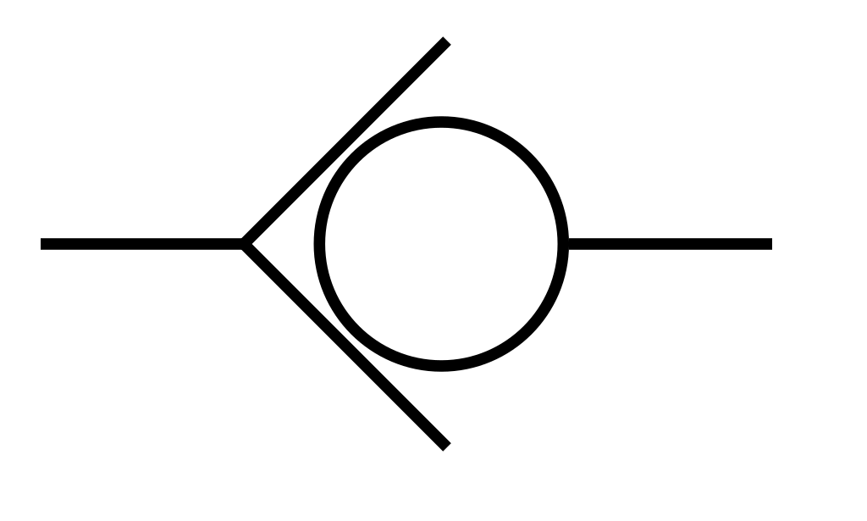
Working method of glucose fluid stopper
In response to this critical level , the system automatically closes the valve controlling the saline flow. This action, often controlled by a mechanism like a solenoid plunger , prevents air from entering the patient’s bloodstream and stops blood into the empty saline bottle.

Slide 6
Thank You

